Slide 1
TERM TEST 1 REVIEW
APS106

Slide 2
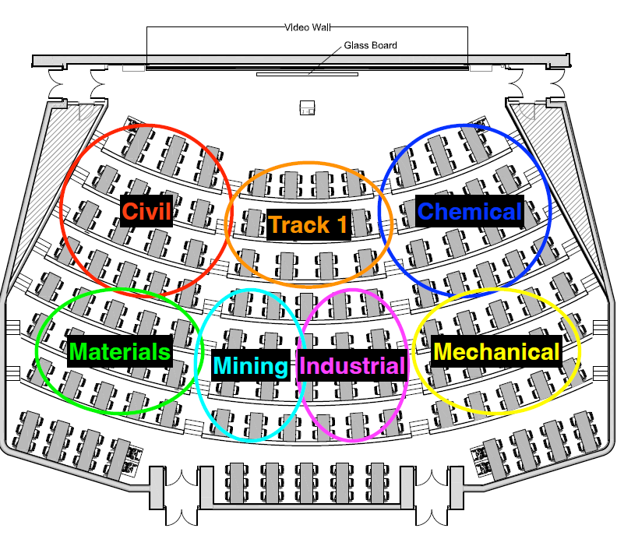

Slide 3
Rules of the GAME
Must use button on the table to answer question verbally and explain your answer – you will be called on to answer by one of the instructors
Must tell us which discipline you’re in before you answer for points (we’ll rely on the honour system)
If you get the answer right, you pick the next category
If you get the answer wrong, the next person whose hand is up can steal
Everyone is here to learn and review for the midterm so be kind to everyone who answers!

Slide 4
Panel
THE GOOD, the BAD, and the FUNCTION
WHILE, WHILE, WHILE
To output or not to OUTPUT
String Theory
$250
$250
$250
$250
$500
$500
$500
$500
$750
$750
$750
$750
$1000
$1000
$1000
$1000
Final Jeopardy

Slide 5
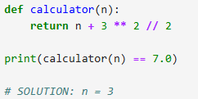
What value of n to print True?
THE GOOD, the BAD, and the FUNCTION · $250
Question board

Slide 6
What value of n to print True?
THE GOOD, the BAD, and the FUNCTION · $250
Question board

Slide 7
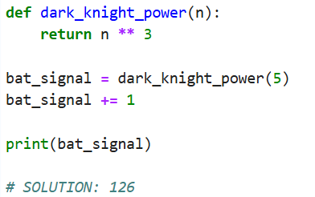
What is the output?
THE GOOD, the BAD, and the FUNCTION · $500
Question board

Slide 8
What is the output?
THE GOOD, the BAD, and the FUNCTION · $500
Question board

Slide 9
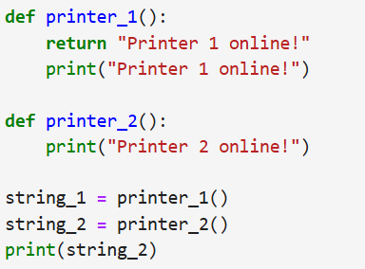
What is the output?
THE GOOD, the BAD, and the FUNCTION · $750
Question board

Slide 10

What is the output?
THE GOOD, the BAD, and the FUNCTION · $750
Question board

Slide 11
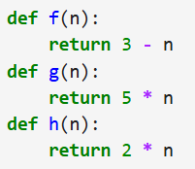
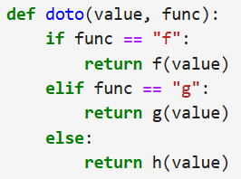

What is the output?
THE GOOD, the BAD, and the FUNCTION · $1000
Question board

Slide 12
What is the output?
THE GOOD, the BAD, and the FUNCTION · $1000
Question board

Slide 13
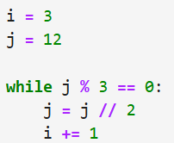
What are the values of i and j at each cycle until the loop finishes?
WHILE, WHILE, WHILE · $250
Question board
Notes:
Go to python notebook

Slide 14

What are the values of i and j at each cycle until the loop finishes?
WHILE, WHILE, WHILE · $250
Question board
Notes:
Go to python notebook

Slide 15
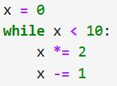
How many times does the body of the while loop get executed?
WHILE, WHILE, WHILE · $500
Question board

Slide 16
How many times does the body of the while loop get executed?
WHILE, WHILE, WHILE · $500
Infinite times! It never ends.
Question board

Slide 17
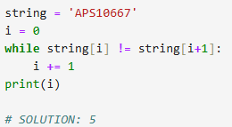
WHILE, WHILE, WHILE · $750
How many times does the body of the while loop get executed?
Question board

Slide 18
WHILE, WHILE, WHILE · $750
How many times does the body of the while loop get executed?
Question board

Slide 19
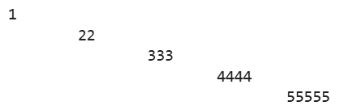
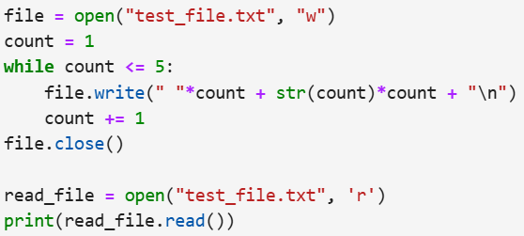
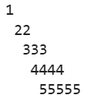


WHILE, WHILE, WHILE · $1000
What is stored in test.file.txt?
a.
b.
c.
d.
Question board
Notes:
Infinite

Slide 20
WHILE, WHILE, WHILE · $1000
What is stored in test.file.txt?
b.
Question board
Notes:
Infinite

Slide 21
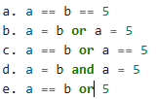
Which of the following is True when a is equal to b or equal to 5?
To output or not to OUTPUT · $250
Question board

Slide 22
Which of the following is True when a is equal to b or equal to 5?
To output or not to OUTPUT · $250
Question board

Slide 23
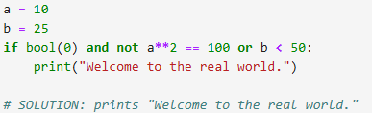
Will it print?
To output or not to OUTPUT · $500
Question board
Notes:
No output

Slide 24
Will it print?
To output or not to OUTPUT · $500
Question board
Notes:
No output

Slide 25
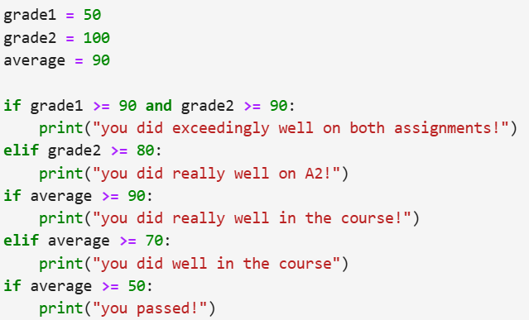
What is the output?
To output or not to OUTPUT· $750
Question board
Notes:
120

Slide 26

What is the output?
To output or not to OUTPUT· $750
Question board
Notes:
120

Slide 27

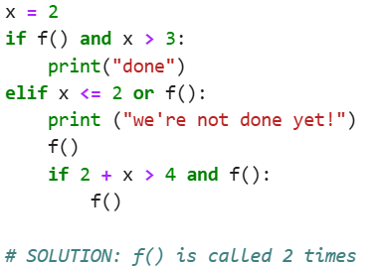
How many times will f() be called?
To output or not to OUTPUT · $1000
Question board
Notes:
C

Slide 28
How many times will f() be called?
To output or not to OUTPUT · $1000
Question board
Notes:
C

Slide 29
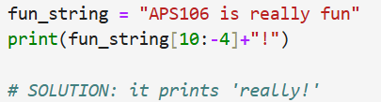
What is the output?
String Theory · $250
Question board
Notes:
6

Slide 30
What is the output?
String Theory · $250
Question board
Notes:
6

Slide 31
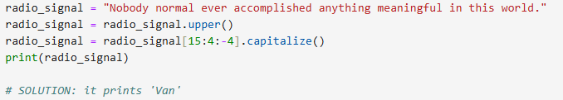
What is the output?
String Theory· $500
Question board
Notes:
You passed a course with grade: 100

Slide 32
What is the output?
String Theory· $500
Question board
Notes:
You passed a course with grade: 100

Slide 33
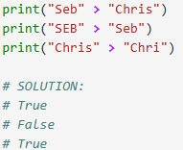
What is the output?
String Theory · $750
Question board

Slide 34
What is the output?
String Theory · $750
Question board

Slide 35

What is the output?
String Theory · $1000
Question board
Notes:
21

Slide 36
What is the output?
String Theory · $1000
Question board
Notes:
21

Slide 37
Final Jeopardy

Slide 38
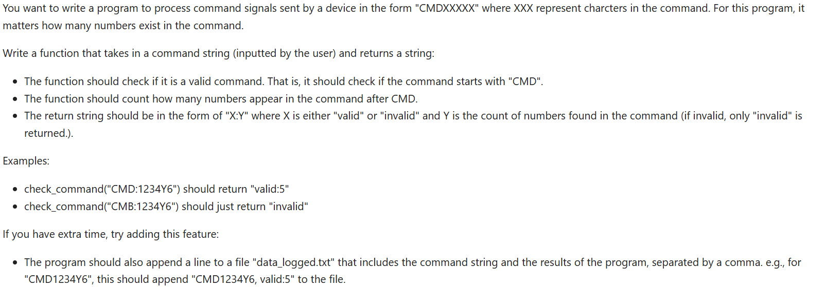
FINAL JEOPARDY

Slide 39
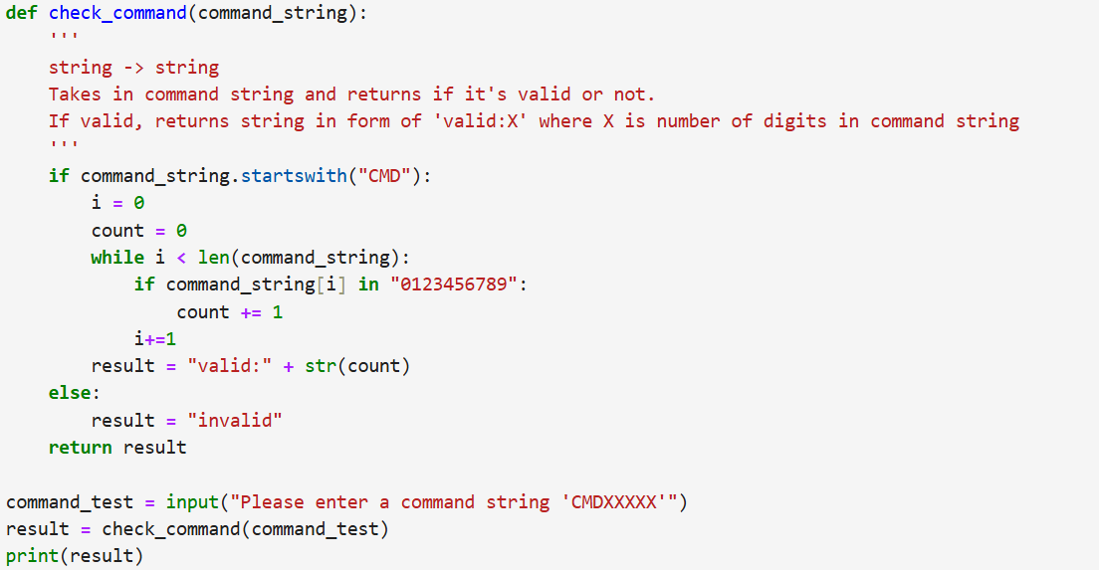
FINAL JEOPARDY - Answer

Slide 40
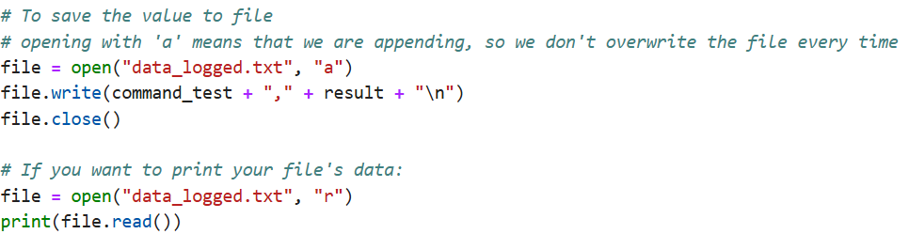
FINAL JEOPARDY – Answer Bonus

